Slide 1
Sustainable Resource Management

Slide 2
Outline
Motivation
Conventional Approach
Systems Approach: Principles for Optimizing the Waste Management Method
Example: Simple vs. Complex Systems
Amplify Benefits
Waste Disposal Priorities
Plastic Waste
Dry Biomass
Human Waste
Animal Waste
Organic Waste
Towards a Sustainable Home

Slide 3
Renewable and Nonrenewable Resources
Perpetual/Continuous resources are those that remain available in the same measure for an indefinitely long time e.g. Solar, Wind, Geothermal, Wave power
Renewable resources can be replenished over fairly short spans of time, such as months, years or decades. E.g. Biomass energy, biofuels, Hydroelectric power generation
Nonrenewable resources take millions of years to form and accumulate, e.g. All fossil fuels like coal, oil, natural gas; uranium, thorium (nuclear fuel)

Slide 4
Ecological Footprint > Earth’s Biocapacity
Ecological Footprint is the amount of biologically productive land and sea area needed to supply the resources a human population consumes, and to assimilate associated waste.
The ability of Earth to replenish the used (renewable) resources and absorb or deactivate the waste and pollution caused by our activities is called as Earth’s biocapacity.
It is reported in area units.
It attempts to quantify the human demand on the Earth's ecosystems.
Can be calculated for an individual, a family, an organization, a country or the entire human population on the earth.

Slide 5
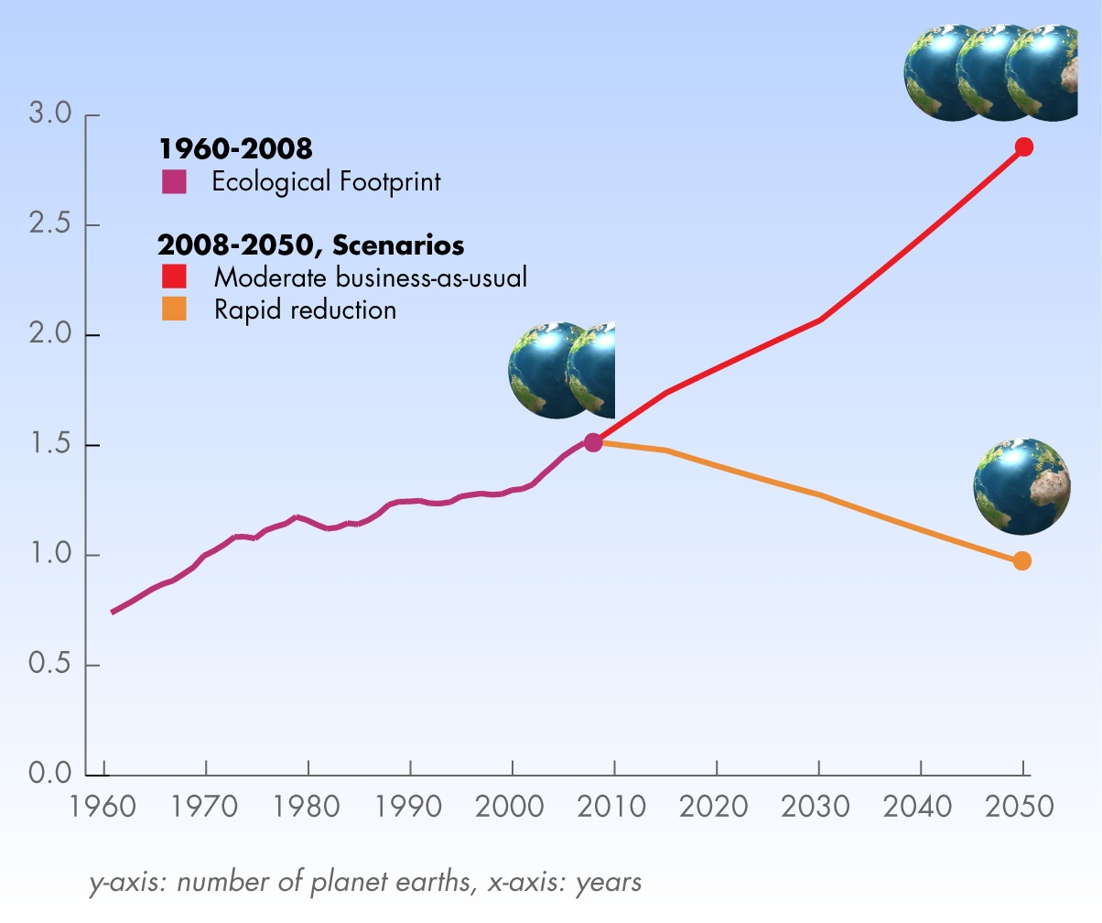
Humanity’s Ecological Footprint
UAE: 10.68 gha/pc
USA: 8.00 gha/pc
China: 2.21 gha/pc
India: 0.91 gha/pc
Humanity is using up ecological services 1.5 times as fast as Earth can renew them.^{[2]}
World Footprint www.footprintnetwork.org

Slide 6
Ecological Footprint > Earth’s Biocapacity
Human activities use up or degrade Earth’s resources and generate waste and pollution but Earth regenerates/restores (biocapacity).
Why is humanity’s ecological footprint large?
High resource extraction.
Generation of large amounts of waste and pollution.
How can the footprint exceeds the area of the earth?
Earth’s biocapacity is only the renewable biocapacity (renewable resources).
It does not include the non-renewable resources.
But we are using a lot of non-renewable resources.
To restore the damage done by their use, we need an area in excess of Earth’s surface area.

Slide 7
Ecological Footprint > Earth’s Biocapacity
Human population and the demand of resources is increasing at alarming rates.
But natural resources are dwindling rapidly.
Forests, grasslands, wetlands, mangroves, coral reefs and all ecosystems are degrading.
Then there is the problem of waste and pollution
At some point an abrupt collapse of these ecosystems is likely.
The services provided by them are degrading and might cease abruptly, with tragic consequences.

Slide 8
This model of development is not sustainable.
We need SUSTAINABLE DEVELOPMENT

Slide 9
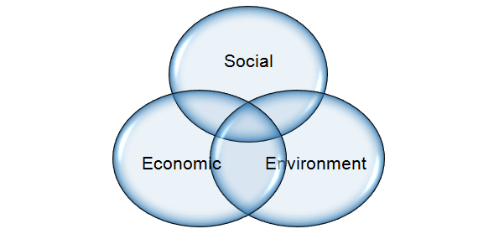
Sustainable Development (SD)
SD is the economic development to meet human needs while preserving the environment.
Meet needs into the indefinite future.
Present economic growth is unsustainable since it leads to social inequities and environmental damage.
Economy, Society, Environment: 3 interdependent and mutually reinforcing pillars of SD.

Slide 10
How do we bring about sustainability?

Slide 11
Stop deforestation and plant trees
Replace fossil fuels with renewable energy and fuels
Remove poverty and hunger
Reduce, Recycle, Reuse
Ideas for Solving Unsustainability
Protect wildlife and habitats
Conserve water
Enforce pollution control
Stop corruption and crime
Change the government!

Slide 12
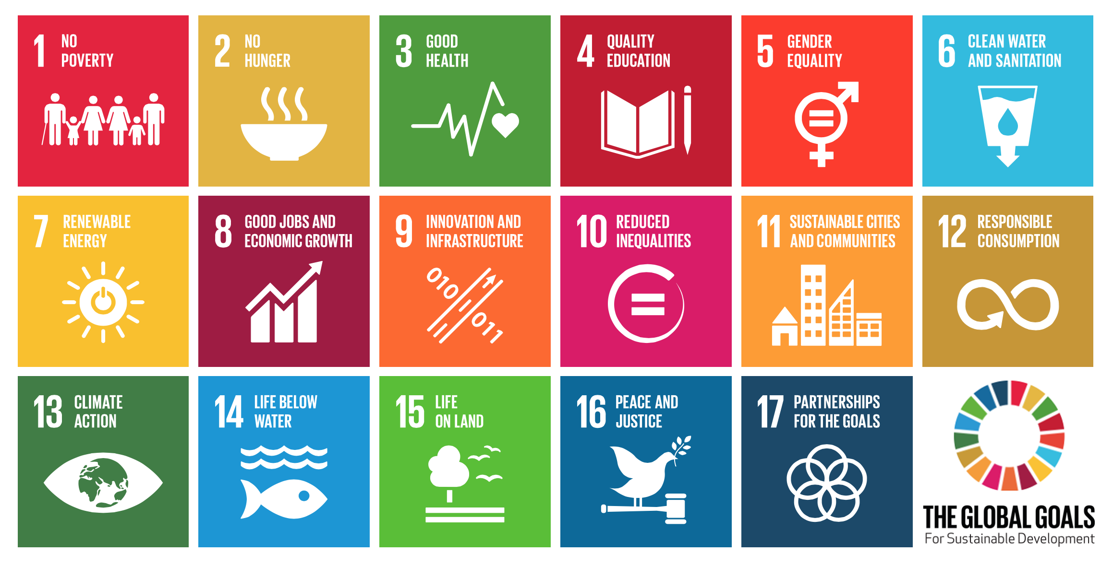
UN’s Sustainable Development Goals
https://en.wikipedia.org/wiki/Sustainable_Development_Goals

Slide 13
These ideas are alright.
But if we all try to work on each one of them independently, it won’t lead to sustainability.
Why?
Because….

Slide 14
Outline
Interrelations in Nature
Present Unsustainability
Sustainable Development
Inadequacy of a Fragmented Approach
Design for Sustainability
Integrated Resource Management
Requirements for Sustainability
Consumption, Sustainability and Well Being
Fundamental Necessity of Education for Sustainability

Slide 15
Interactions in Socio-Environmental Problems
Environment
Water Crisis
Food Crisis
Energy Crisis
Economy
Government
Culture
Human Society

Slide 16
Achieving Sustainable Development
Then how to achieve sustainability?
Let’s begin by trying to see some of the ways by which sustainability can never be achieved...

Slide 17
What is not sustainable
Sustainability “greenwash”:
A company or organization claiming to be “green” through advertising and marketing instead of actually implementing business practices that significantly minimize environmental impact. ^{[ref]}
e.g. A petrochemical company adopts a few efficiency measures, changes the color of its logo to green, launches a worldwide ad campaign announcing themselves as a “sustainable company.”
Mere compliance with regulations:
Meeting pollution control board norms.
e.g. a coal-fired power plant can never become sustainable even if it meets emission norms.

Slide 18
What is not sustainable
Superficial solutions will not be enough
E.g. merely tuning up your car engine does not solve the air pollution problem.
E.g. merely avoiding plastic bags does not solve the waste problem.
If each person takes one small step, humanity as a whole will take only one small step.
Mad race for economic growth (GDP)
Uncontrolled economic growth is led by consumerism and fuelled by resource extraction.
It leads to resource depletion and pollution/waste.
It does not ensure social peace (high inequalities).
Will exhaust resources before the poorest get enough to eat!

Slide 19
What is not sustainable
Solving one problem at a time might be impossible.
E.g. Trying to separately solve the food crisis and overpopulation as independent problems.
The problems are highly complex and are related.
Solving one without solving the other is impossible.
Fragmented efforts towards sustainability
Different govt. agencies, NGOs, businesses, industries and individuals, each pursuing their own sustainability goals.
A comprehensive, integrated approach is needed.

Slide 20
Understanding Unsustainability
Is it possible that unsustainability is a systemic problem, since it affects all human activities?
In that case, environmental and social problems can be viewed as mere symptoms of a much deeper problem (root cause).
We will discuss this perspective towards the end of this topic.

Slide 21
Understanding Sustainability: Analogy of An Orchestra
Several artists with different instruments
What is not an orchestra:
Merely pretending to play the instrument. (is like greenwash)
Merely playing the prescribed notes. (is like mere compliance with regulations)
Creating as much noise as possible (is like increasing GDP).
Each musician independently playing his/her best. (is like trying to solve one problem independently of others)
What is necessary for a successful orchestra:
Agreement to play one common composition
A commonly agreed-upon plan that includes the role and timing of each musician.
Each musician following the plan with mutual coordination.

Slide 22
Consensus and Understanding About SD
Do countries and corporations agree upon the urgent need for sustainable development?
As of now, not adequately.
Most agree in principle, but differ in approach and level of commitment.
Do thinkers, researchers, experts have an adequate understanding about sustainability and the practical steps?
There is some understanding of what will not lead to sustainability.
And the understanding of what exactly will lead to it, is still evolving.
More thought and mutual discussions are necessary.
But there have already been interesting developments...

Slide 23
Consensus and Understanding About SD
Will the rest follow those who understand?
We’ll have to see for ourselves!
But individual industries, groups of industries, countries and groups of countries are taking the lead.
Some are even setting the standards.
Convergence of efforts is required:
As our understanding evolves…
As methodologies and approaches evolve…
Policies must follow suit.
Industries and consumers must rapidly adopt the new developments.
One thing is certain:
If we want significant progress towards sustainability, we must be prepared to make significant changes to our way of living and doing things.

Slide 24
What is the new understanding that we have gained about sustainability and about how to achieve it?

Slide 25
Outline
Interrelations in Nature
Present Unsustainability
Sustainable Development
Inadequacy of a Fragmented Approach
Design for Sustainability
Integrated Resource Management
Requirements for Sustainability
Consumption, Sustainability and Well Being
Fundamental Necessity of Education for Sustainability

Slide 26
Sustainability Must Be Designed
Sustainability is possible only after deliberate design both at the system level and the component or process level.
Sustainability cannot be the product of disconnected or fragmented solutions in an environment that is skewed by technology, markets and policies.
E.g. Making biofuels from corn/sugarcane and using for transportation seems like a good idea.
This is because of various skewing factors such as subsidies, market prices, and policies.
Actually, it can worsen the food crisis and can be unsustainable.

Slide 27
Need for Systems Thinking
Systems thinking is necessary for solving interconnected problems.
The WHOLE is more than just the sum of the individual PARTS.
E.g. Putting together all the parts of a car in any random order does not make a functional car.
Each part is related to other parts in a specific way and contributes to the functioning of the whole.
Design is necessary both at the component level and the system level. (e.g. each part must be properly designed and the entire car must also be properly designed.)
Diagnosing and correcting malfunctions in complex and interrelated problems requires systems thinking.
Watch this video Systems thinking: an introduction (3.31 min)
Systems thinking: a cautionary tale (cats in Borneo) (3.08 min)

Slide 28
To apply systems thinking for solving unsustainability, let’s begin with the management of natural resources.
There is something seriously wrong with the way we presently use resources...

Slide 29
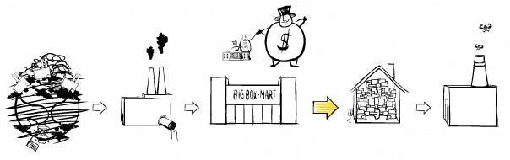
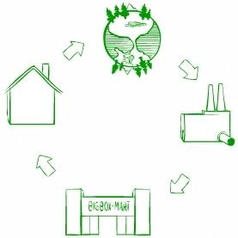
Present Open Loop System (Unsustainable)
Linear System
Resource Depletion
Waste Accumulation
Watch the video: The Story of Stuff (21min) or read transcript
What we need is a...
Closed Loop System (Sustainable)
Waste of one process is used as a resource for another process.
Net extraction of new resources is minimized.
Cyclic System

Slide 30
So sustainable development demands circular (cyclical) resource use at a global level.
How to convert our present linear resource use system to a circular one?
Let’s understand this through the example of our home...

Slide 31
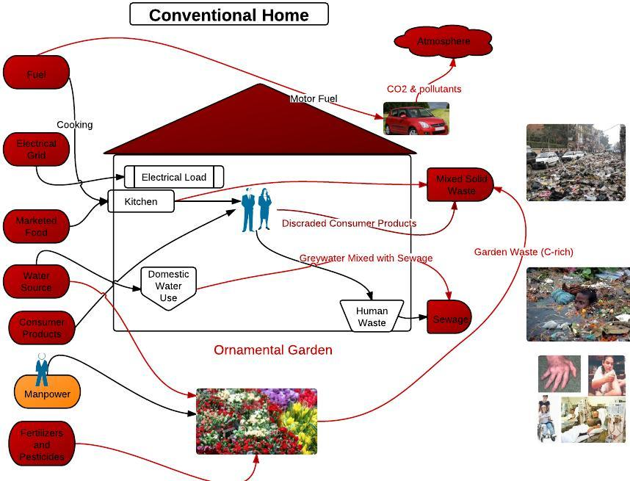
Inputs (resources)
Output (waste)
Linear Flow of Materials

Slide 32
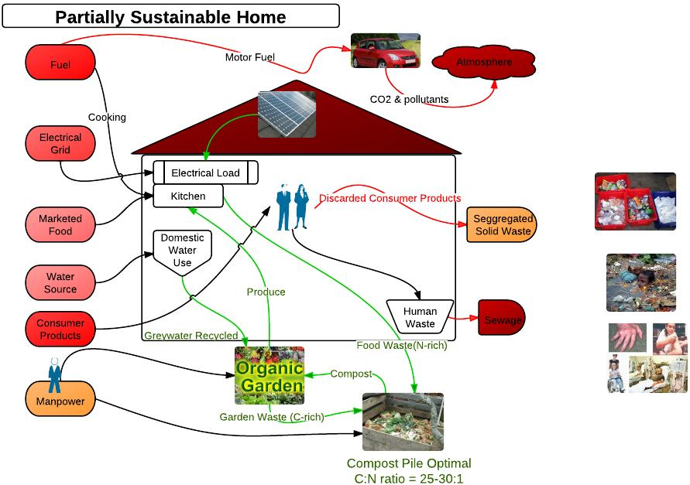

Slide 33
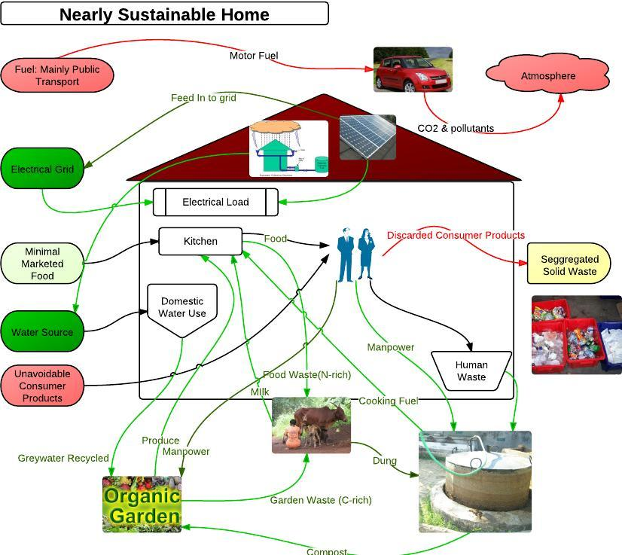

Slide 34
The same principle can be extended to industries…

Slide 35
Change in Approach of Industries
Old approach: Compliance with environmental regulations.
New Approach:
Comprehensive pollution prevention strategies & environmental management systems.
Life Cycle Analysis (LCA): “cradle-to-grave” approach for assessing cumulative environmental impacts from raw material acquisition to waste disposal.
Design for the Environment
Industrial Ecology Industrial Symbiosis

Slide 36
Product Life Cycle Assessment
Watch Videos
Life Cycle Assessment (4.56 min)
Life Cycle Assessment in 6 minutes Crash Course series - 2011

Slide 37
Product Life Cycle Analysis
Atmospheric Emissions
Raw Materials Acquisition
Raw Materials
Manufacturing
Liquid effluents
Solid Wastes
Energy
Transporation
Co-Products
Water
Use/Reuse/Maintenance
Other Releases
Disposal/Recycle
EPA: LCA 101 document (PDF), Additional LCA Resources.

Slide 38
LCA Process
Goal Definition and Scoping:
Product/process definition & context of assessment.
Identify the boundaries and env. effects to be assessed.
Inventory Analysis:
Quantify energy, water and material inputs and releases (flows).
Impact Assessment:
Assess the potential human and ecological effects of the flows from the inventory analysis.
Interpretation:
From inventory analysis and impacts & select the preferred product, with a clear understanding of the uncertainty and the assumptions used.

Slide 39
LCA Benefits
Enables decision-makers select product/process with least env. impacts (compared with cost, performance etc.)
Identifies the transfer of environmental impacts from one media to another
E.g., eliminating air emissions by creating a wastewater effluent instead) and/or from one life cycle stage to another (e.g., from use and reuse of the product to the raw material acquisition phase).

Slide 40
LCA Limitations
Need to carefully weigh the availability and accuracy of data, time and financial resources required against the projected benefits of the LCA.
Resource and time intensive.
Gathering some data could be difficult.
Inaccurate data can greatly impact the results.
LCA will not determine which product or process is the most cost effective or works the best.
LCA should be used as one component of a more comprehensive decision process assessing the trade-offs with cost and performance, e.g., Life Cycle Management.

Slide 41
Life Cycle Management (LCM)
Voluntary application of life cycle thinking to manage the total life cycle of an organization’s product and services toward more sustainable consumption and production.
An integrated framework of concepts and techniques to address environmental, economic, technological, and social aspects of products, services, and organizations.

Slide 42
Design for the Environment (DfEt )
Design for environmental processing and manufacturing:
Extraction and manufacturing processes are safe for environment and people.
Design for environmental packaging:
Eco-friendly packaging (reuse, recycle, efficient use).
Design for disposal or reuse:
Designed for reuse, refurbishing, disassembly, recycle.
Design for energy efficiency:
Low overall energy consumption throughout the product's life.
Source: http://en.wikipedia.org/wiki/Design_for_the_Environment

Slide 43
Design for the Environment (DfEt )
Watch Videos:
The Secret Life of Things Animation 2010 (6 min)
Eco-design in 6 minutes Crash Course series – 2011
What You Probably Didn’t Learn in Design School.(30 min)

Slide 44
Cradle-to-Cradle and the Circular Economy
Beyond Reduce-Reuse-Recycle (LESS BAD)
From LESS BAD to GOOD
Design for Sustainability
Cradle to Cradle (5.50min)
The Circular Economy (7.00 min)
The Circular Economy: Re-thinking Progress (3.49 min)
The circular economy: from consumer to user (3.14 min)
Circular Economy: Bandvulc - circular economy case study (1.30 min)
Circular Economy: Business Case Study 1- Interface Flor (6.15min)
Circular Economy: Business Case Study 2: Nike (5.23 min)

Slide 45
Industrial Ecology
Industrial Ecology India Part 1 (10.28 min)
Industrial Ecology India Part 2.avi (1.5 min)
Industrial Symbiosis at Kalundborg (2.36 min)
www.roionline.org

Slide 46
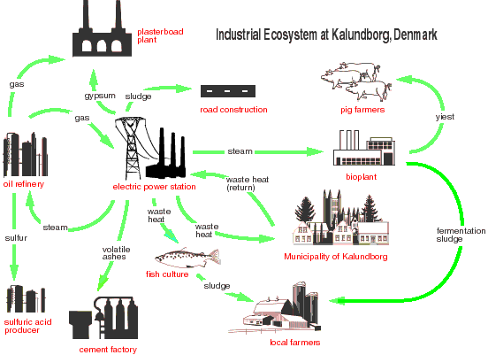
Industrial Symbiosis
One company's waste is another company's treasure
http://fleeingvesuvius.org/wp-content/uploads/2011/06/kalundborg_opt.jpeg

